Slide 1
GRAMENER CASE STUDY
Group Members :
Oshin Sharma
Chirag Sharma
Pranav Haldar
Ashutosh Kumar Singh

Slide 2
Overview
Background of Problem
A consumer finance company which specializes in lending various types of loans to urban customers needs to make a good business decision for loan approval based on the applicant’s profile in order to enhance the profits.
Company Business Objectives
The company wants to understand the driving factors behind loan default i.e. the variables which are strong indicators of default.
The company intends to utilize this knowledge for its portfolio and risk assessment.
Aim
The aim of study is to identify patterns which indicate if a person is likely to default, which may be used for taking actions such as denying the loan, reducing the amount of loan, lending (to risky applicants) at a higher interest rate etc.

Slide 3
Problem Analysis
The data contains details of about 4 years of loans that have been issued by the bank. The loans have been categorise into:
Fully Paid
Current
Charged Off
Based on their repayment status.
Assumptions:
Since on-going loans can’t give insights to loan defaults. The current loan data has been ignored for the analysis
Removed outliers based on annual income and loan amount for the analysis to not be skewed

Slide 4
Problem Solving Methodology
To ascertain the driving factors behind loan default, Study group has carried the activities for Cleaning out the data , prepared it and then carried out EDA to
Identify important variables/personal history parameters of loan/consumers
Visualize the distribution of loan amounts for understand the lending trends over time
Ascertain reasons for the default
Study and visualize the demographic nature of loan defaults
Compute and validate correlations between loan status and indicators for defaulting consumers
Steps Followed
Gather data for analysis
Clean and Format the data for readability
Extrapolate and Derive Metrics
Filter out the outliers
Filter data set on loan status
Perform Univariate and Bivariate analysis on the data
Visualise using plots and observe the patterns

Slide 5
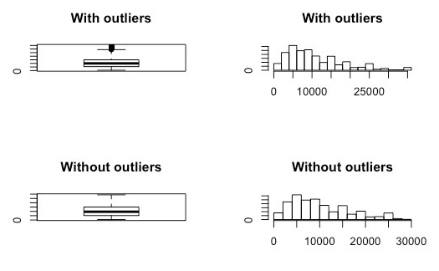
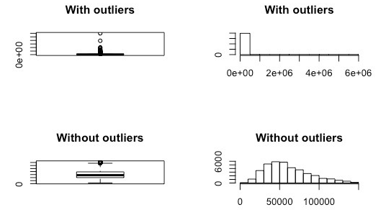
Outlier Analysis
Annual Income
Loan Amount
Removed outliers for Annual Income and Loan Amount to achieve close to normal distribution of the sample

Slide 6
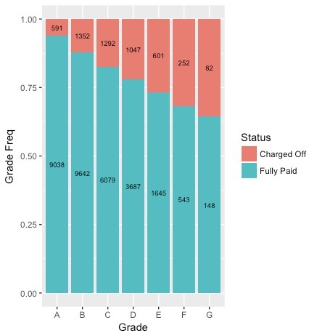
Loan Grade and Loan Status
It can be observed from the plot that the later loan grades have a higher proportion of loan default %age
Thus it can be established that a later loan grade is more risky in comparison to an earlier loan grade with respect to the proportion of charged off loans

Slide 7
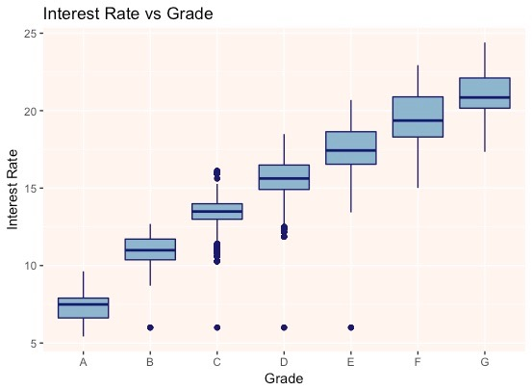
Loan Grade and Interest Rate
Higher interest rates are being charged for later loan grades in line with high risk high gain theory thus higher chances for an loan approved at a higher rate to turn out to be charged off because of higher risk involved in such loans
Thus banks should look at providing more loan to less risky grades at marginally higher or same rates if they want to reduce their risk of having to charge off a loan
Banks are anticipating huge profits in risky loans given they pay it off completely but are facing even higher losses after having to charge them off because of defaults in loan repayment

Slide 8
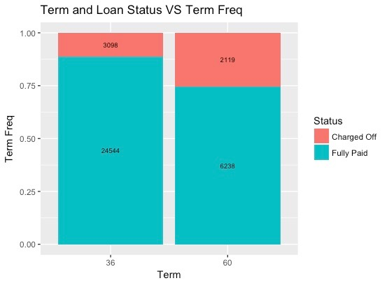
Loan Term and Loan Status
There are two loan terms 36 months and 60 months; 36 month can be classified as short term loan and 60 months as long term on a relative scale
We observe that the term of the loan plays a huge role in the final status of the loan as we found that a short term loan is far more likely to be re-paid in full
Whereas the loan status is more likely to be charged off for a long term loan
Also it is clearly evident from the plot that long term loans have higher proportion of defaults in comparison to short term loans

Slide 9
Loan Term and Loan Grade
 |  | A | B | C | D | E | F | G | Row Total
36 | count | 9242 | 8855 | 5496 | 3031 | 782 | 187 | 49 | 27642
 | %age | 33.43% | 32.03% | 19.88% | 10.97% | 2.83% | 0.68% | 0.18% | 100%
60 | count | 426 | 2425 | 2106 | 1901 | 1609 | 650 | 192 | 9309
 | %age | 4.58% | 26.05% | 22.62% | 20.42% | 17.28% | 6.98% | 2.06% | 100%
Overall | count | 9668 | 11280 | 7602 | 4932 | 2391 | 837 | 241 | 36951
 | %age | 26.16% | 30.53% | 20.57% | 13.35% | 6.47% | 2.27% | 0.65% | 100%
High risk grades as established earlier are being given more long term loans whereas less risky grades are being given mostly short term loan thus making the long term prospects riskier and also larger in magnitude

Slide 10
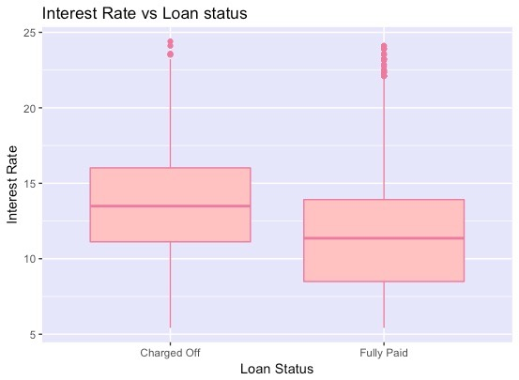
Interest Rate and Loan Status
It can be observed from the above plot that charged off loans have significantly higher interest rates

Slide 11
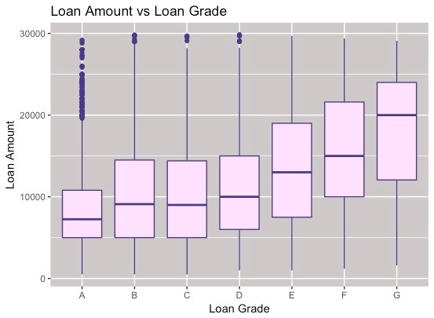
Interest Rate and Loan Amount
To maximise the profit even the higher loan amounts are being provided to later loan grades by the banks along with high interest rates
This multiplies the risk of the bank as per the trends observed

Slide 12
Verification Status and Loan Status
 |  | Charged Off | Fully Paid | Row Total
Not Verified | count | 2098 | 14214 | 16312
 | %age | 12.86% | 87.14% | 100%
Source Verified | count | 1348 | 7744 | 9092
 | %age | 14.83% | 85.17% | 100%
Verified | count | 1771 | 8824 | 10595
 | %age | 16.72% | 83.28% | 100%
Overall | count | 5217 | 30782 | 35999
 | %age | 14.49% | 85.51% | 100%
There seems to be something not correct with the verification process because supposedly if the loan has been given after a proper verification process then the chances of it being charged off should be lesser in comparison to the unverified loans
But as per the observations charged off loans are higher in proportion for verified loans (16.72%) and lesser for unverified loans (12.86%) when compared to the overall proportion of charged off loan (14.49%)
Its an hypothesis which the bank should check at their end to verify the observation from data

Slide 13
Conclusion
Parameters that were observed to have correlation with default loans based on the data provided are:
Loan Term
Interest Rates
Loan Amount
Loan Grade
Verification Status (Anomaly)
Using the above parameters we should be able predict with a fair probability if the current loan is going to be charged off or not
This could be implemented by the Loan Company to implement a risk analysis practice in the assessment process

